Slide 1


MDaS Bootcamp: Python for Machine Learning
Spring 2024
Karuna Bhaila, Alycia Carey, Xintao Wu

Slide 2
Outline
Two 1.5-hour sessions; we will cover following topics
Data Preprocessing
Cleaning data
Missing values
Continuous Attributes
Machine Learning
Decision Trees (DT)
Naïve Bayes (NB)
Support Vector Machines (SVMs)
Neural Networks (NNs)

Slide 3
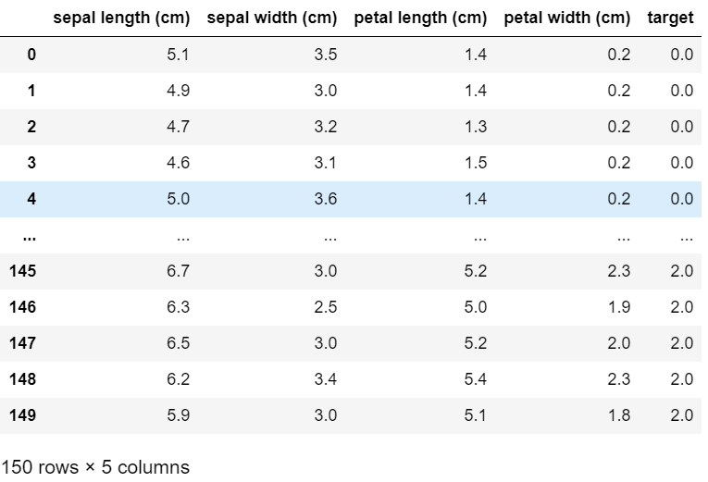

Dataset: Iris

Slide 4
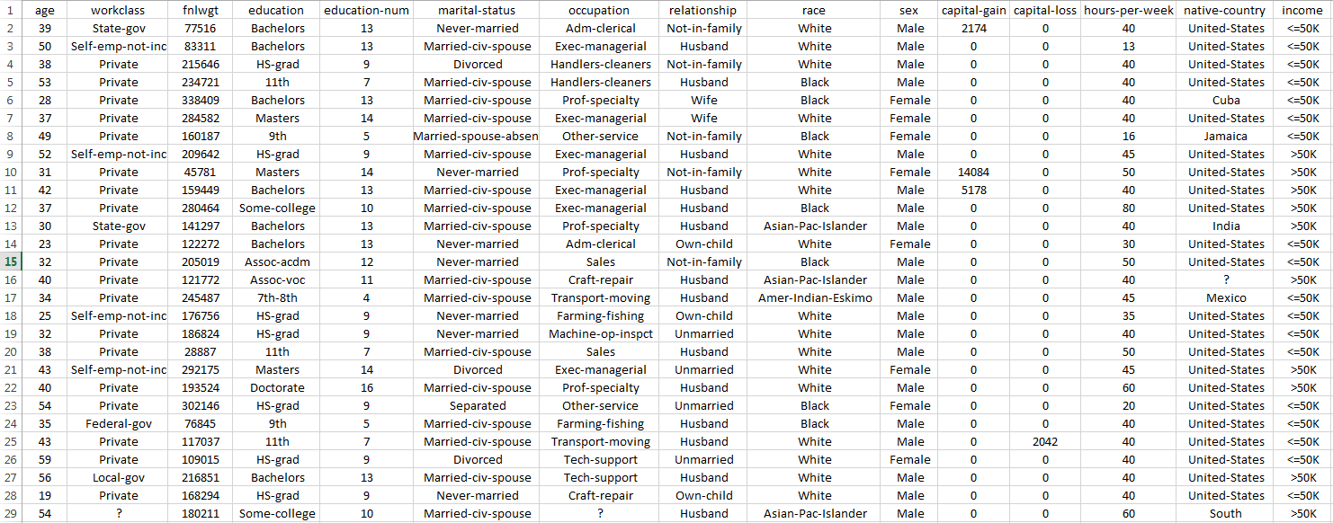
Dataset: Adult

Slide 5
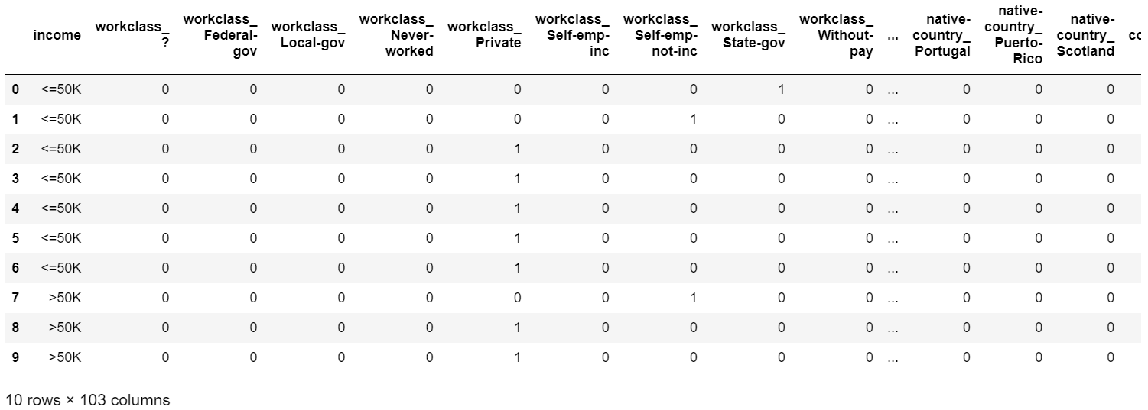
Dataset: Pre-processed Adult

Slide 6
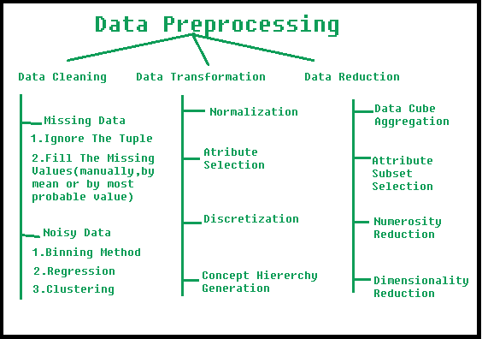
Data Preprocessing
Manipulation of data before use
Transform plain-text information to numerical data that can be used in computations
Fill or discard missing values
One-hot encoding
Transform numerical attributes to specific ranges
Reduce dimensions
https://www.geeksforgeeks.org/data-preprocessing-in-data-mining/

Slide 7
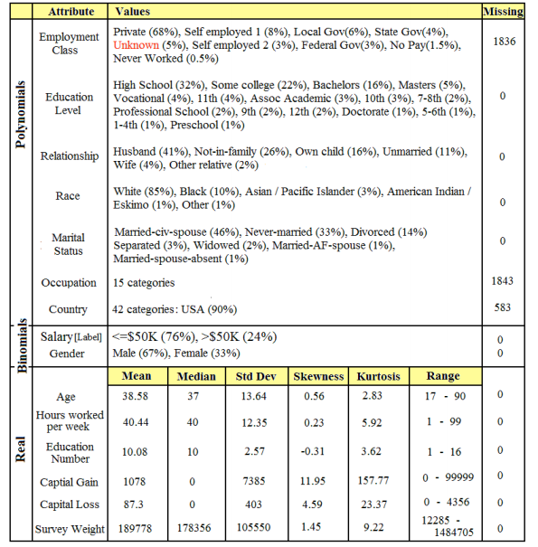
Data Preprocessing
How do we decide?
Domain knowledge
Analyze data statistics; you can do this analysis with Pandas and NumPy

Slide 8
Data Preprocessing: Adult
We will perform the following operations
Refer to Task 1 notebook for code
Clean data
Remove “.” from income
Remove “?”
Reduce dimensions
Select only categorical attributes
Transform
One-hot encoding
Add missing attributes

Slide 9
What is machine learning?
Specifically, statistical machine learning
Divided into supervised learning, unsupervised learning, and reinforcement learning
No support for RL in scikit-learn
High-level: learn to predict something from data
Slides adapted from https://jorge-a-mendez.github.io/teaching/

Slide 10
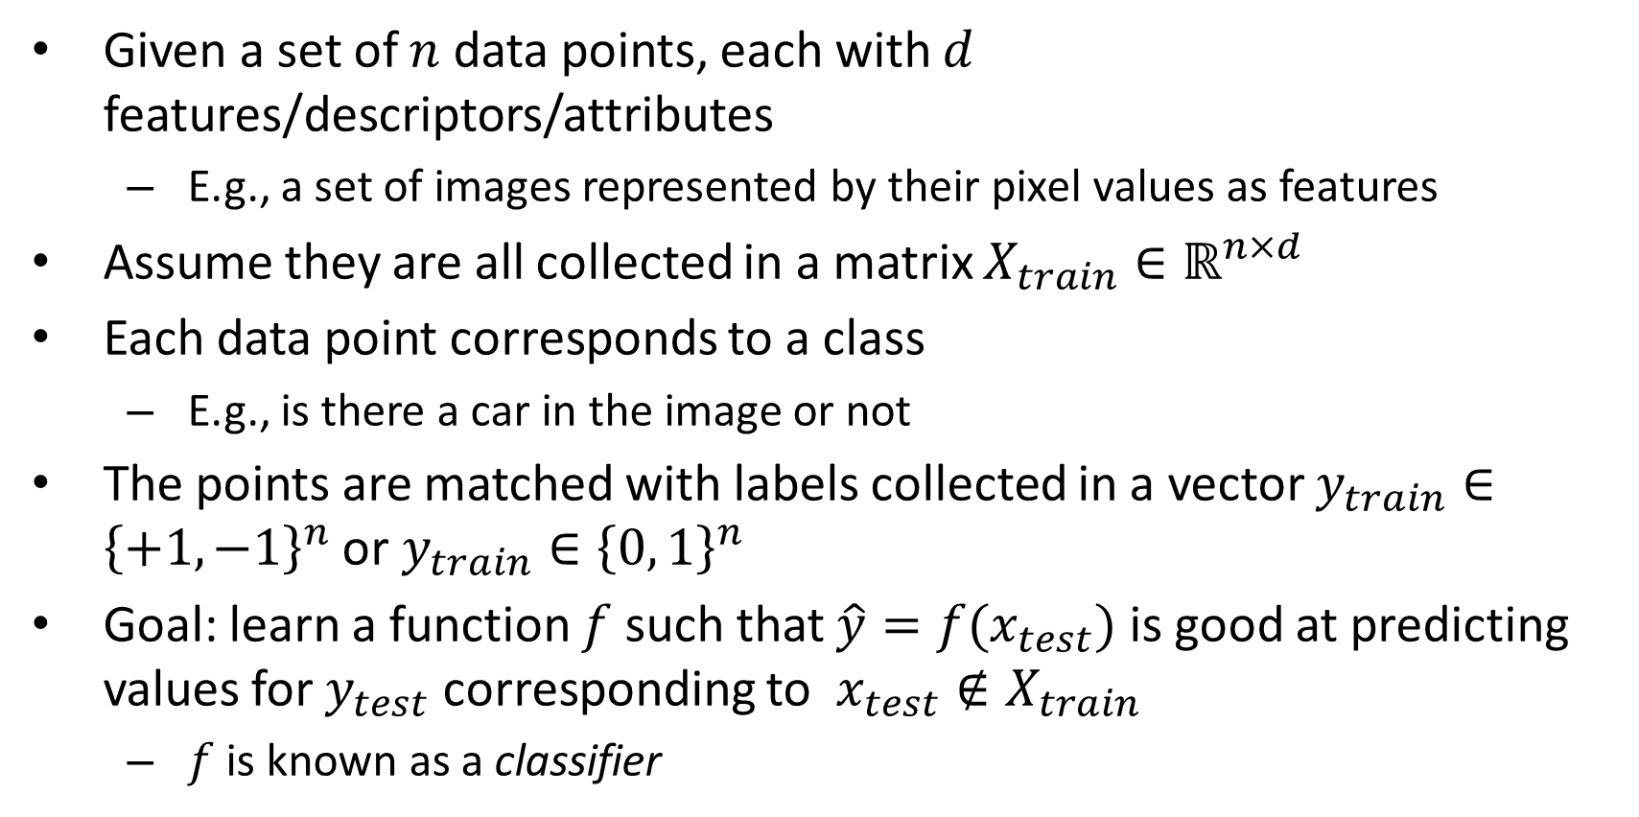
Supervised learning: Classification
Given a set of $n$ data points, each with $d$ features/descriptors/attributes
E.g., a set of images represented by their pixel values as features
Assume they are all collected in a matrix $X_{train}∈ℝ^{n×d}$
Each data point corresponds to a class
E.g., is there a car in the image or not
The points are matched with labels collected in a vector $y_{train}∈{\left\{+1,−1\right\}}^{n}$ or $y_{train}∈{\left\{0, 1\right\}}^{n}$
Goal: learn a function $f$ such that $\hat{y}=f(x_{test})$ is good at predicting values for $y_{test}$ corresponding to $x_{test}∉X_{train}$
$f$ is known as a classifier

Slide 11
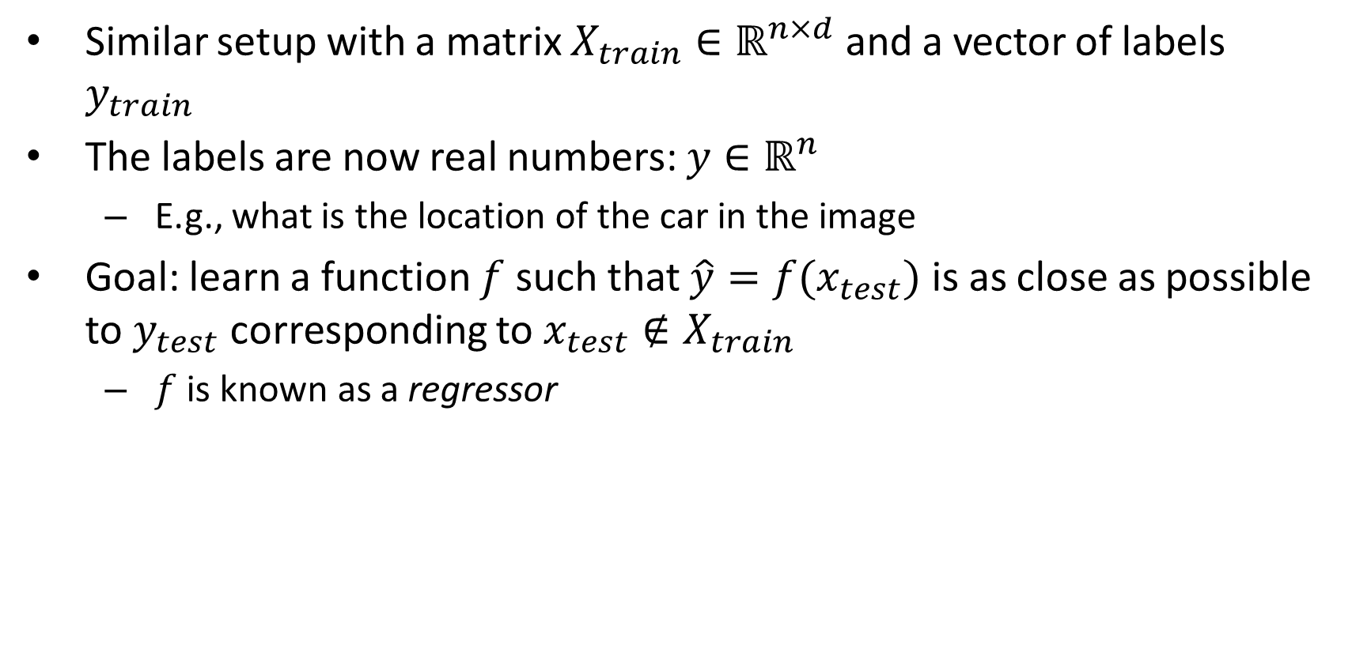
Supervised learning: Regression
Similar setup with a matrix $X_{train}∈ℝ^{n×d}$ and a vector of labels $y_{train}$
The labels are now real numbers: $y∈ℝ^{n}$
E.g., what is the location of the car in the image
Goal: learn a function $f$ such that $\hat{y}=f(x_{test})$ is as close as possible to $y_{test}$ corresponding to $x_{test}∉X_{train}$
$f$ is known as a regressor

Slide 12
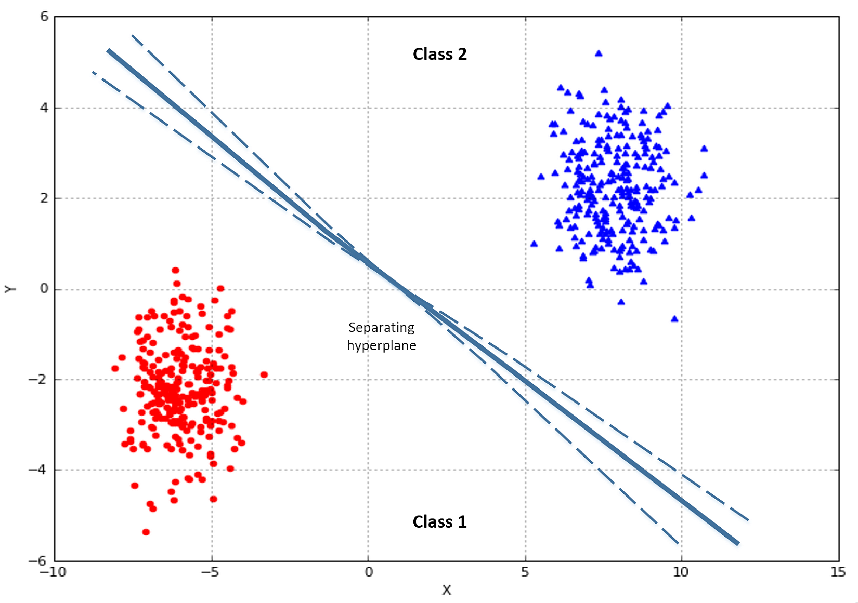
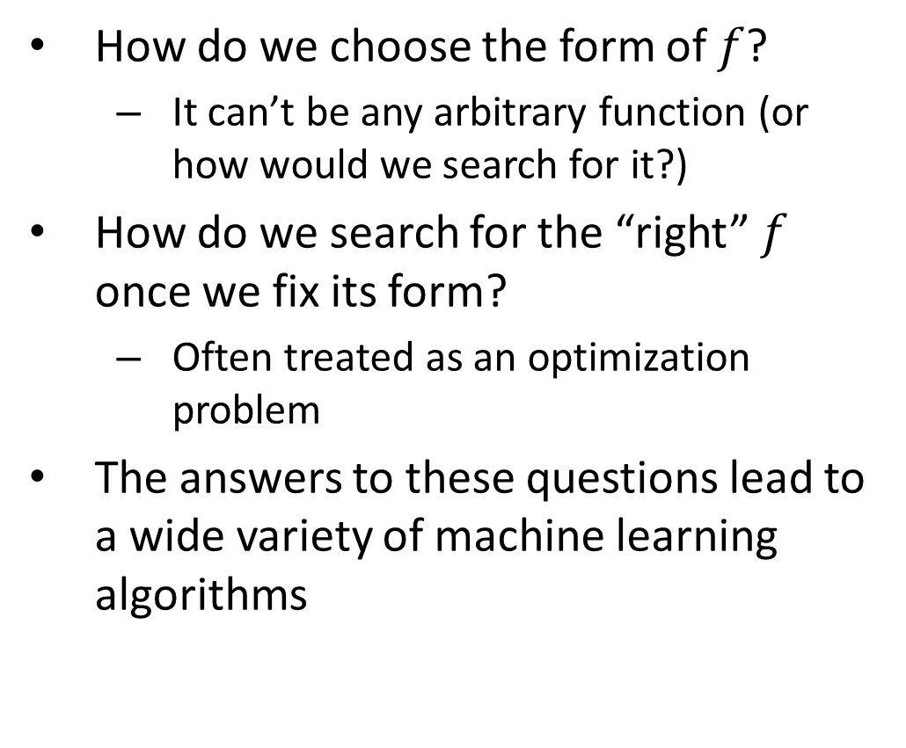
How to solve ML?
How do we choose the form of $f$?
It can’t be any arbitrary function (or how would we search for it?)
How do we search for the “right” $f$ once we fix its form?
Often treated as an optimization problem
The answers to these questions lead to a wide variety of machine learning algorithms

Slide 13
ML in scikit-learn
Predictive data analysis tool for Python; uses SciPy, NumPy, and Matplotlib
Provides a selection of efficient tools for machine learning and statistical modeling
Methods
fit(X, y) — find the optimal weights
predict(X) — return the predicted y
accuracy_score(y, y_pred) — quantify correctness

Slide 14
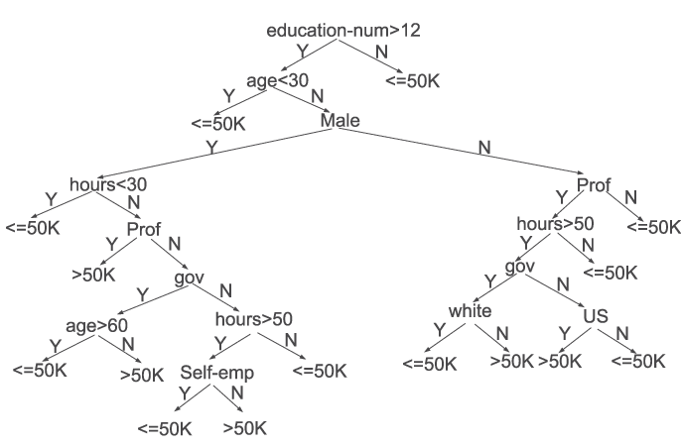
Tree-based model
A series of “if-then” rules to generate predictions from one or more decision trees
Decision Trees
Rule-based model
Non-parametric
Learn decision rules i.e.: yes/no questions from features in training data
One question = one node
https://arxiv.org/pdf/1508.03812.pdf

Slide 15
Decision Trees in scikit-learn
scikit-learn-decision-tree
scikit-learn implementation does not support categorical variables for now
Method
dtree = DecisionTreeClassifier()
dtree.fit(X_train, Y_train)
predictions = dtree.predict(X_test)

Slide 16
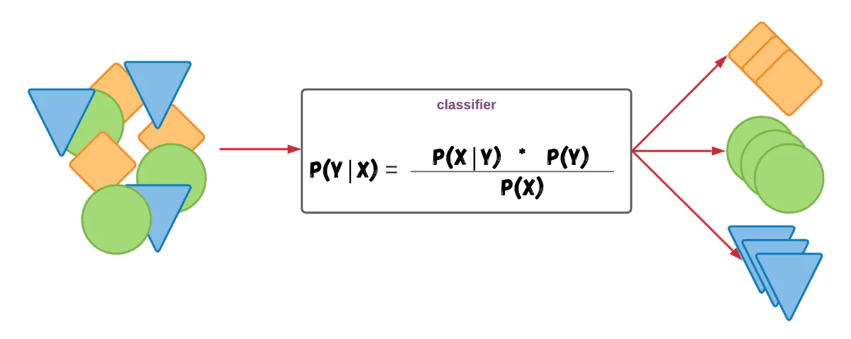
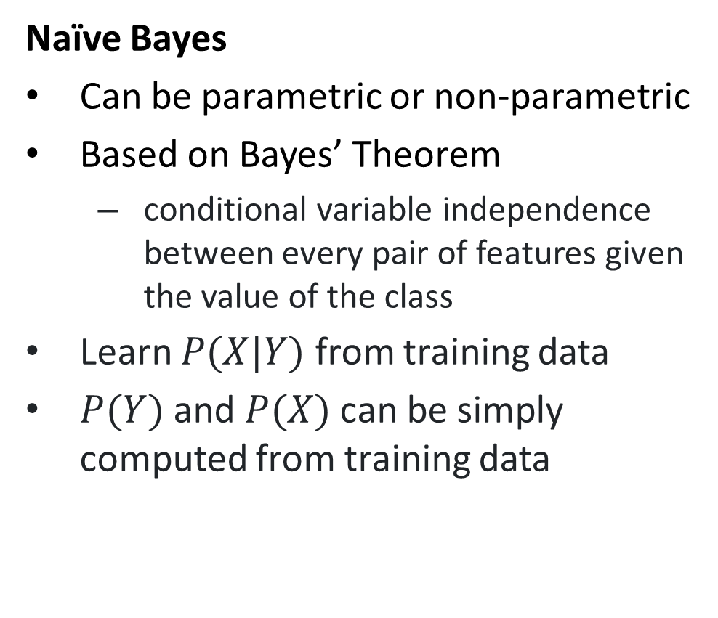
Probabilistic Model
Naïve Bayes
Can be parametric or non-parametric
Based on Bayes’ Theorem
conditional variable independence between every pair of features given the value of the class
Learn $P(X|Y)$ from training data
$P(Y)$ and $P(X)$ can be simply computed from training data
https://thinkinfi.com/naive-bayes-algorithm-in-machine-learning-with-python/

Slide 17
Naïve Bayes in scikit-learn
scikit-learn-naive-bayes
GaussianNB implements the Gaussian Naive Bayes algorithm for classification.
Method
gnb = GaussianNB()
gnb.fit(X_train, Y_train)
predictions = gnb.predict(X_test)

Slide 18
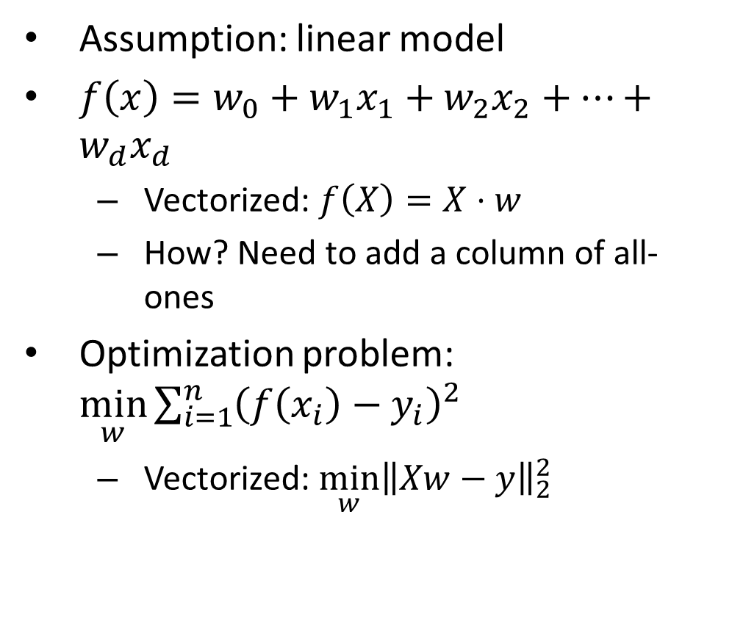
Linear Regression
Assumption: linear model
$f\left(x\right)=w_{0}+w_{1}x_{1}+w_{2}x_{2}+⋯+w_{d}x_{d}$
Vectorized: $f\left(X\right)=X⋅w$
How? Need to add a column of all-ones
Optimization problem: $\min_{w}{\sum_{i=1}^{n}{{\left(f\left(x_{i}\right)−y_{i}\right)}^{2}}}$
Vectorized: $\min_{w}{{\left\|Xw−y\right\|}_{2}^{2}}$

Slide 19
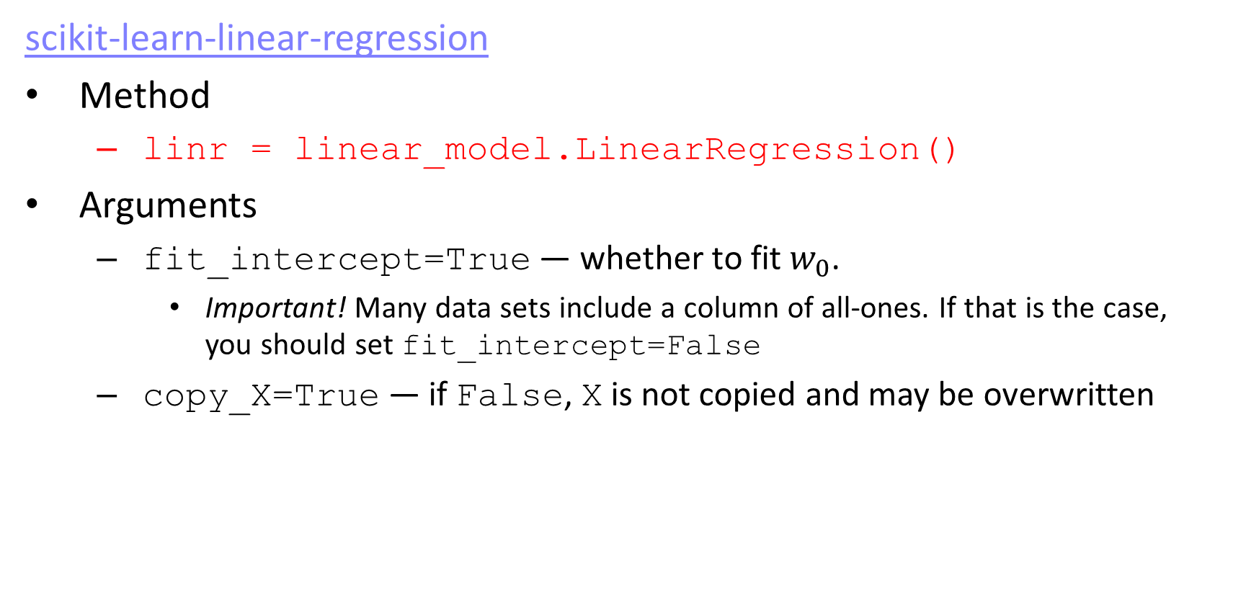
Linear Regression in scikit-learn
scikit-learn-linear-regression
Method
linr = linear_model.LinearRegression()
Arguments
fit_intercept=True — whether to fit $w_{0}$.
Important! Many data sets include a column of all-ones. If that is the case, you should set fit_intercept=False
copy_X=True — if False, X is not copied and may be overwritten

Slide 20
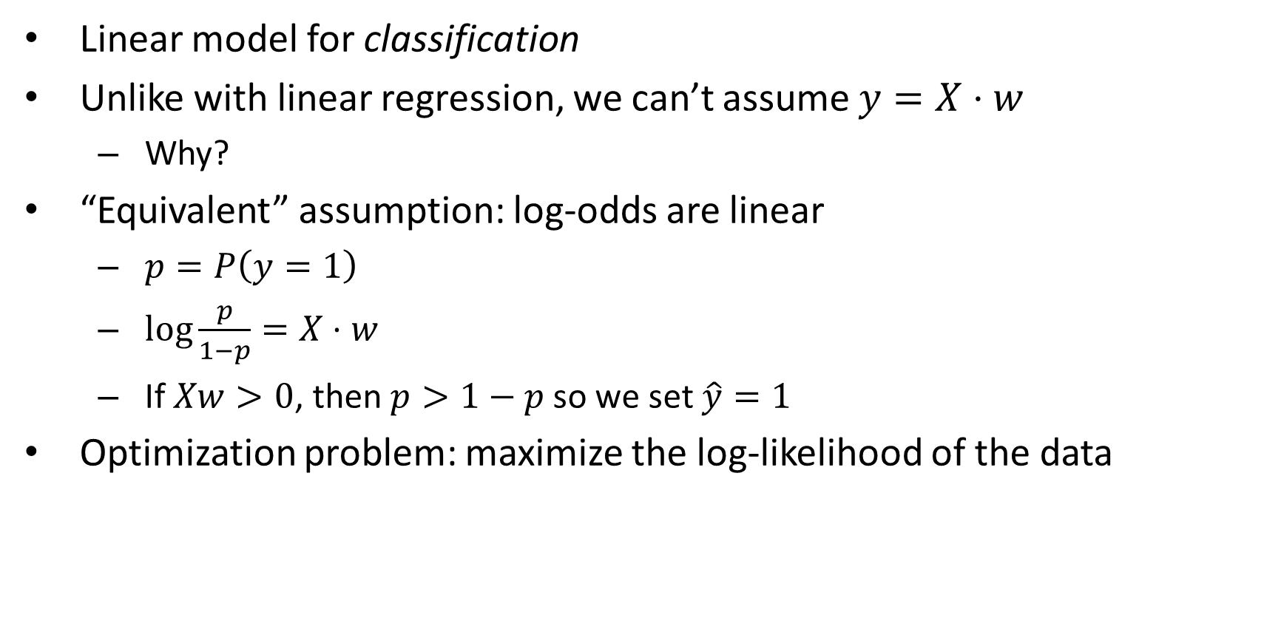
Logistic Regression
Linear model for classification
Unlike with linear regression, we can’t assume $y=X⋅w$
Why?
“Equivalent” assumption: log-odds are linear
$p=P\left(y=1\right)$
$\log{\frac{p}{1−p}=X⋅w}$
If $Xw>0$, then $p>1−p$ so we set $\hat{y}=1$
Optimization problem: maximize the log-likelihood of the data

Slide 21
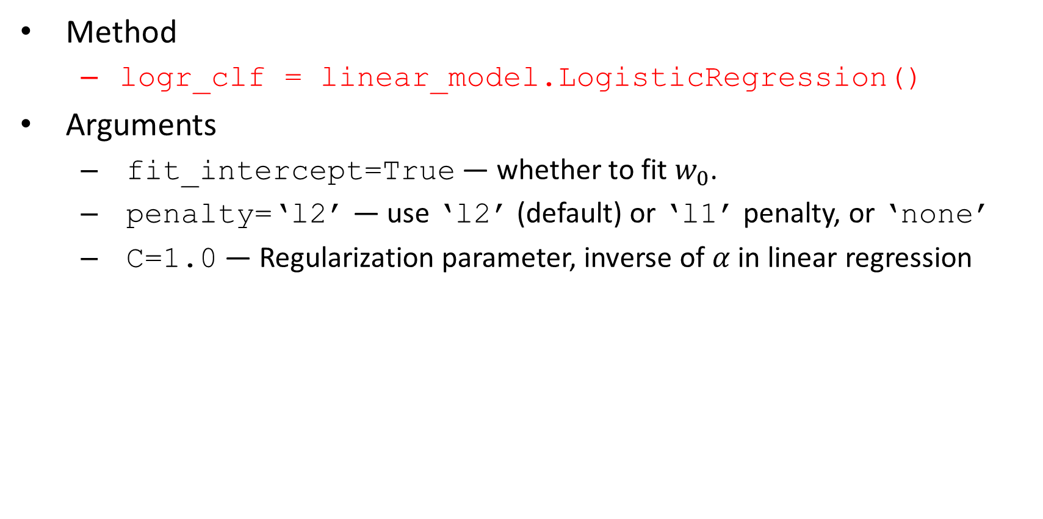
Logistic Regression in scikit-learn
Method
logr_clf = linear_model.LogisticRegression()
Arguments
fit_intercept=True — whether to fit $w_{0}$.
penalty=‘l2’ — use ‘l2’ (default) or ‘l1’ penalty, or ‘none’
C=1.0 — Regularization parameter, inverse of $α$ in linear regression

Slide 22
Non-linearity

Slide 23
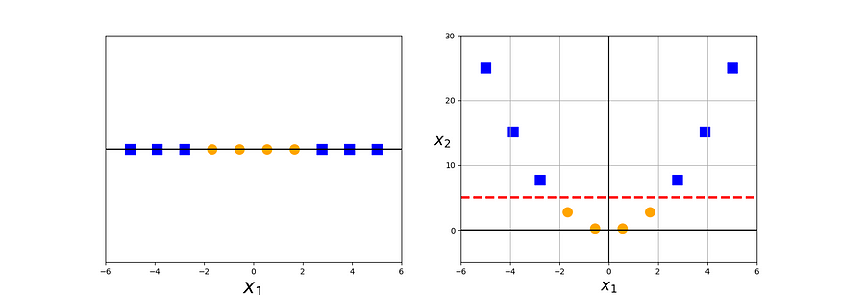
Support Vector Machines
Uses a subset of training points in the decision function (called support vectors)
Incorporates the kernel trick, so complex non-linearities can be added
Cool trick: Gaussian kernel corresponds to infinite features
Any data set becomes linear with a sufficiently fine-grained Gaussian kernel
Note: it is not always a good idea to make your data perfectly linearly separable!
Adds another constraint: focuses only on points near the decision boundary

Slide 24
SVMs in scikit-learn
scikit-learn-svm
Method
svm_clf = svm.SVC()
Arguments
C=1.0 — regularization parameter, as in logistic regression
kernel=‘rbf’ — the type of kernel to use
‘rbf’ — Gaussian or radial basis function kernel
‘linear’ — Introduces no non-linearities
‘poly’ — polynomial non-linearities
degree — of the polynomial in ‘poly’
gamma — smaller gamma means more complex non-linearities for ‘rbf’
probability=False — whether to enable probability estimates
decision_function=‘ovr’ — how to handle multi-class classification
‘ovr’ — one-vs-rest: one model for each class
‘ovo’ — one-vs-one: one model for each pair of classes (quadratically many!)

Slide 25
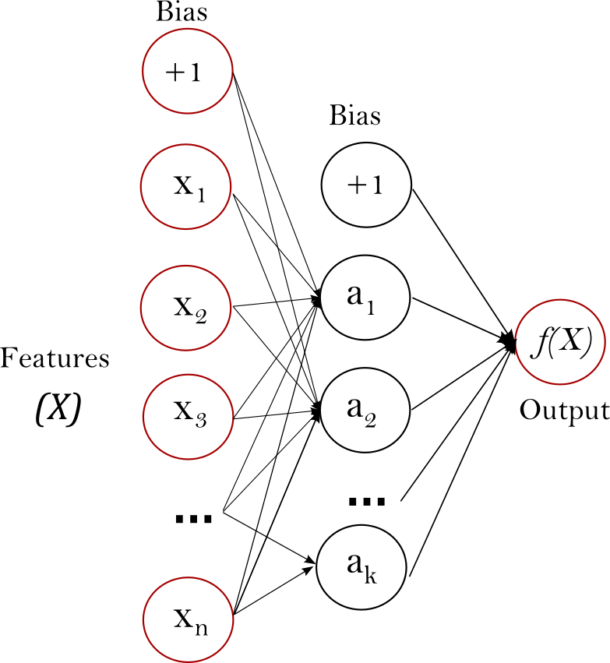
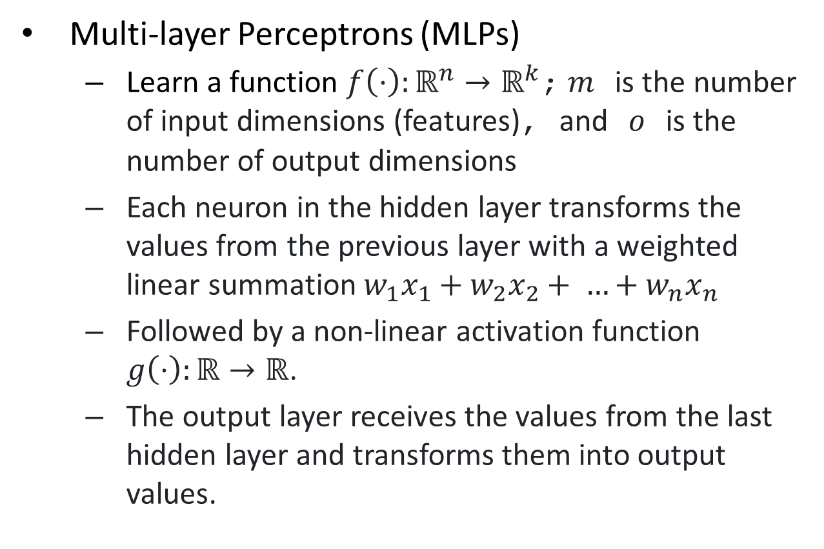
Neural Networks
Multi-layer Perceptrons (MLPs)
Learn a function $f\left(⋅\right):ℝ^{n}→ℝ^{k}$; $m$ is the number of input dimensions (features), and $o$ is the number of output dimensions
Each neuron in the hidden layer transforms the values from the previous layer with a weighted linear summation $w_{1}x_{1}+w_{2}x_{2}+ …+w_{n}x_{n}$
Followed by a non-linear activation function $g\left(⋅\right):ℝ→ℝ$.
The output layer receives the values from the last hidden layer and transforms them into output values.

Slide 26
Neural Networks in scikit-learn
scikit-learn-nn-mlp
Method
mlp = neural_network.MLPClassifier()
Arguments
hidden_layer_sizes=(100,10,) – array of number of neurons in each layer
activation=‘relu’ – non-linearity for the hidden layers
solver=‘sgd’ – weight optimization method
alpha=0.0001 – strength of L2 regularization
learning_rate_init=0.001 – step-size for updating weights

Slide 27
There’s much more to scikit-learn
Resources
https://scikit-learn.org/stable/
You can find example implementations of various classification models
You can also find examples of data preprocessing techniques
Further Reading: PyTorch
Python package with more capabilities
Tensor computation with strong GPU acceleration
Examples: https://github.com/pytorch/examples
Tutorials: https://github.com/yunjey/pytorch-tutorial

